Slide 1
Big Data Clustering
JIN GUO & JURIE GERMISHUYS

Slide 2
Context
Language used: Python
Data used: Wikipedia text (url)
Word embedding performed using Word2Vec
Three clustering algorithms considered:
K-Means (Sci-kit Learn package)
DBSCAN (Sci-kit Learn package)
Hierarchical Clustering (Scipy package)
Big data cases considered: large n (observations) & large k (dimensions)
Performance metric: running time of clustering algorithms

Slide 3
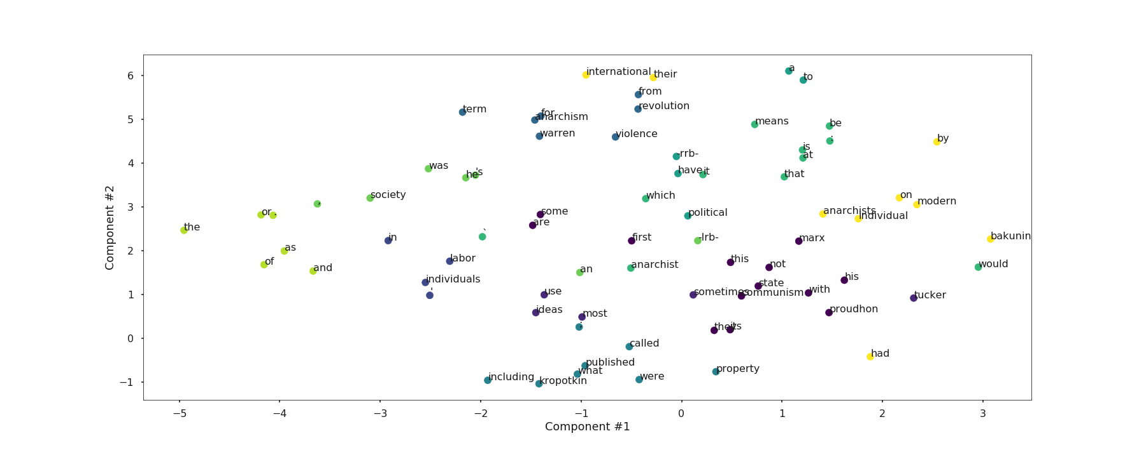
Observations from clustering
Clustering with even a small number of data points resulted in clusters which made sense to some extent.
DBSCAN results were very sensitive to the epsilon parameter, as expected.
High-dimensional data does not change clustering results significantly – which was surprising.
We ran into hardware limitations very quickly with high-dimensionality - with anything above 20000 dimensions for 5000 observations.
Clustering visualisation was difficult beyond 500 embeddings – both in terms of plotting and interpretation.
Observations: 75
Dimensions: 10
(Typically between 50-500)
Observations: 5000
Dimensions: 10

Slide 4
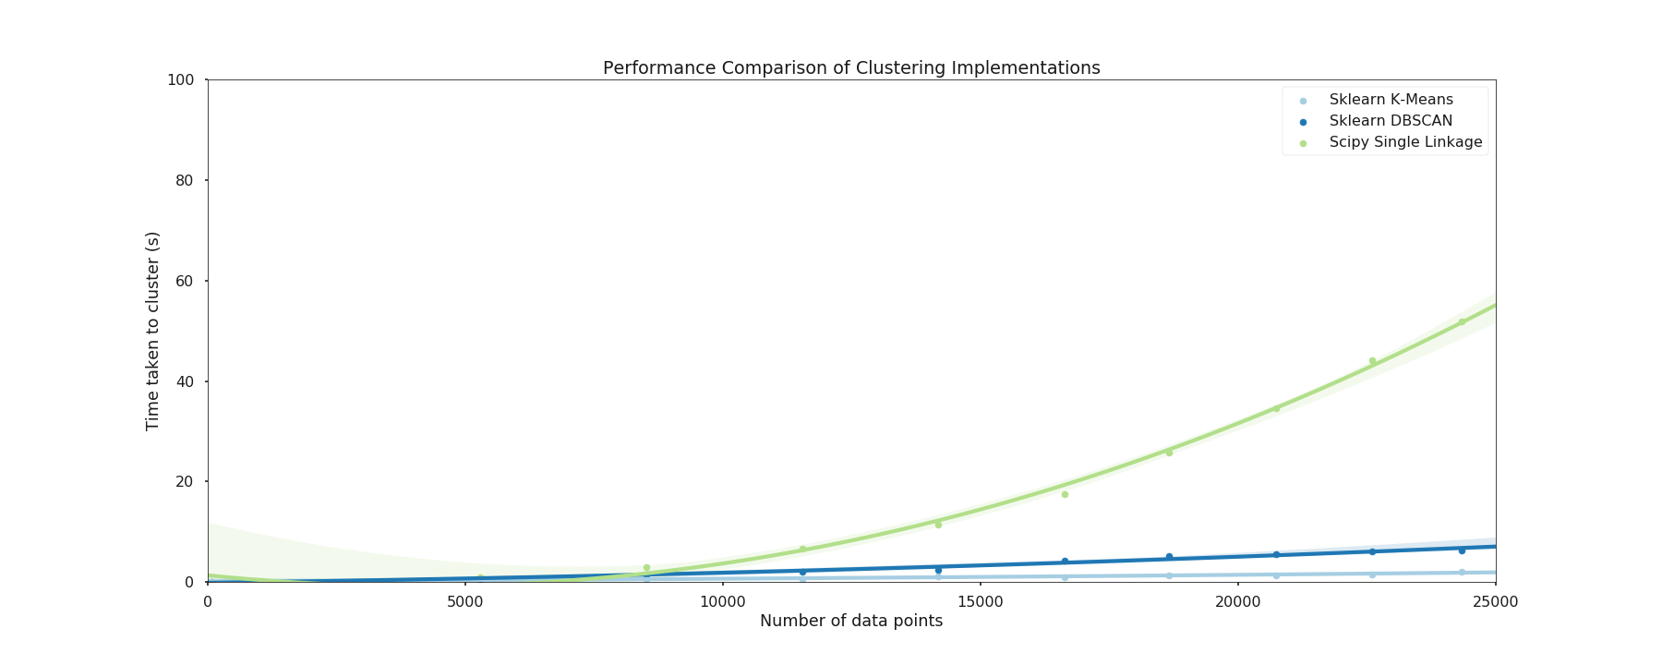
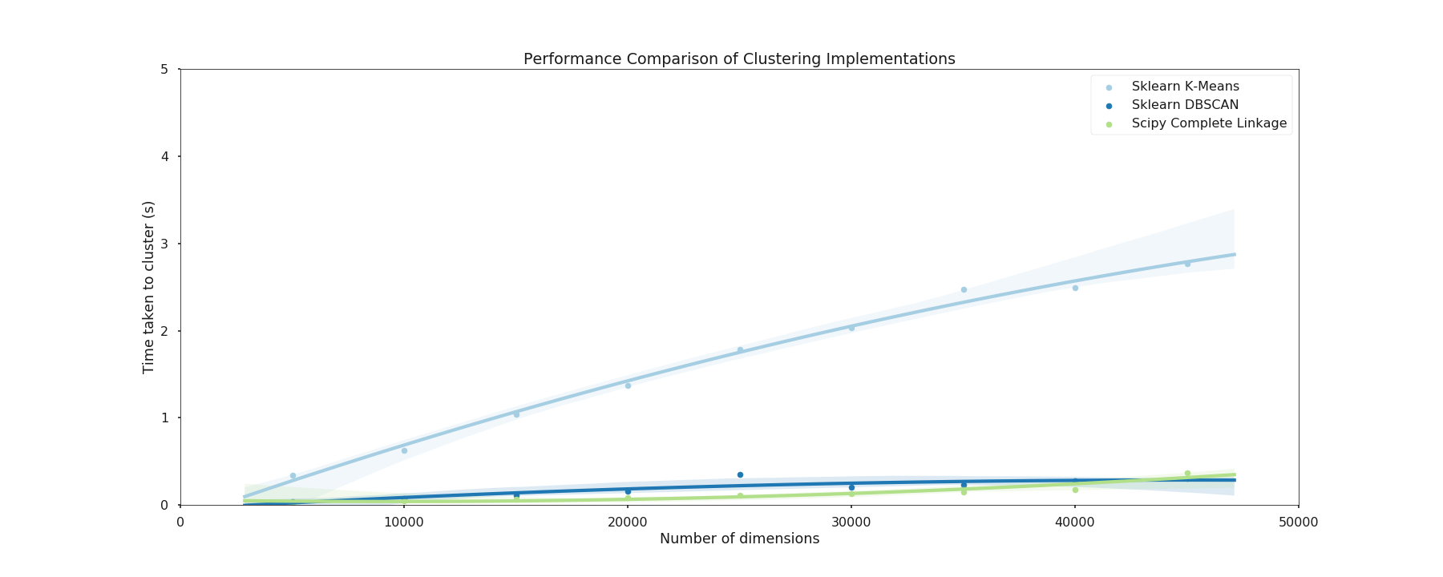
Running time

Slide 5
Reference
Slide from R.Johansson

